Slide 1
HARMONy and dialogues

Slide 2
content
Gesture detector
Await and async
Progress bar

Slide 3
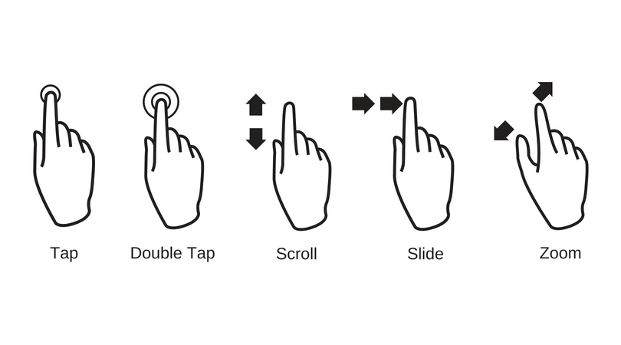
Gesture recognizer
In Flutter, GestureDetector is a widget that allows you to handle various touch events such as taps, swipes, and long presses. It provides a way to recognize gestures in your app, enabling interactive behavior. The GestureDetector widget wraps around a widget and allows you to detect and respond to various gestures.

Slide 4
Await and async
async and await are used for asynchronous programming. They allow you to write asynchronous code in a way that looks and behaves like synchronous code, which can be easier to read and maintain.
async: Marks a function as asynchronous, meaning it will return a Future. Inside this function, you can use the await keyword to wait for the result of a Future.
await: Pauses the execution of the function until the Future completes and returns the value that the Future resolves to.
void timer() async{
For(int i =20;i>=0;i--){
setState((){
timer = i;});
Await Future.delayed(Duration(seconds : 1))}}

Slide 5
Progress bar
In Flutter, a progress bar is typically used to show the user that some work is happening in the background, such as data loading, file uploads, or network requests. There are two common types of progress bars in Flutter:
Linear Progress Indicator: A horizontal bar that shows the progress of a task.
Circular Progress Indicator: A circular spinner that indicates ongoing work.

Slide 6
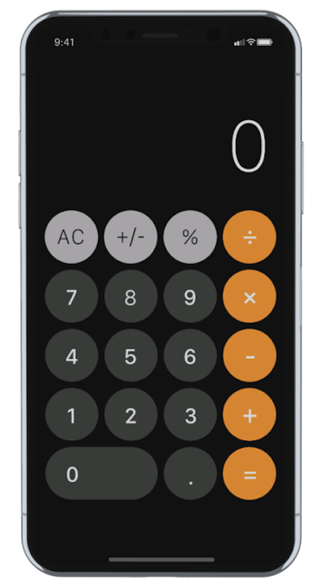
exercise
Calculator with all its function

Slide 7
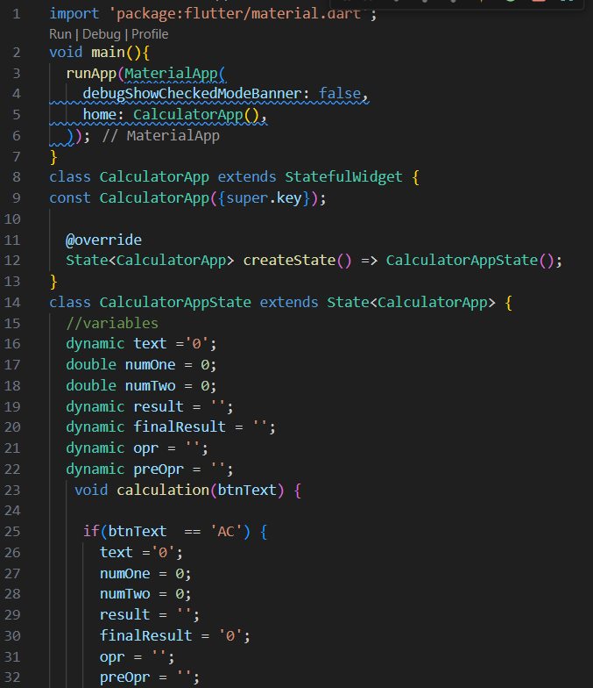
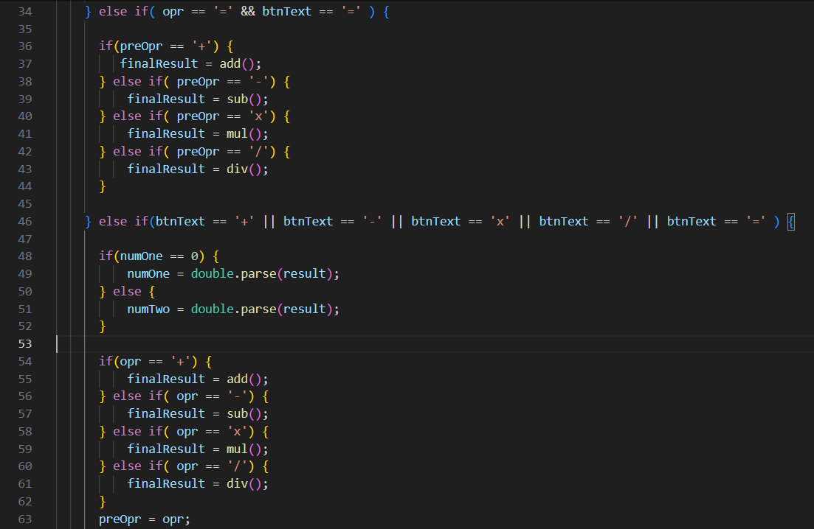
exercise

Slide 8
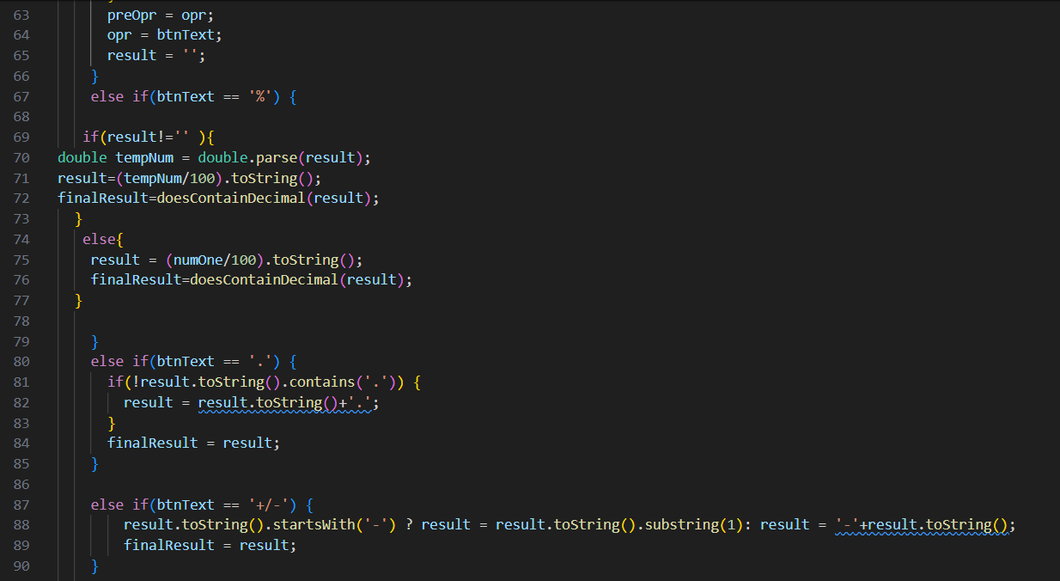
exercise

Slide 9
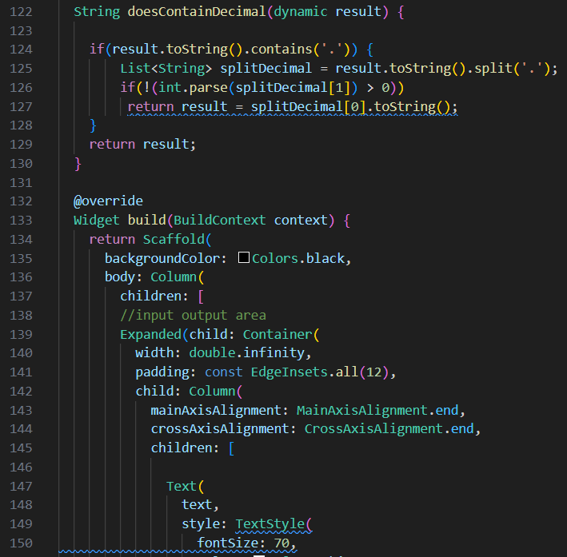
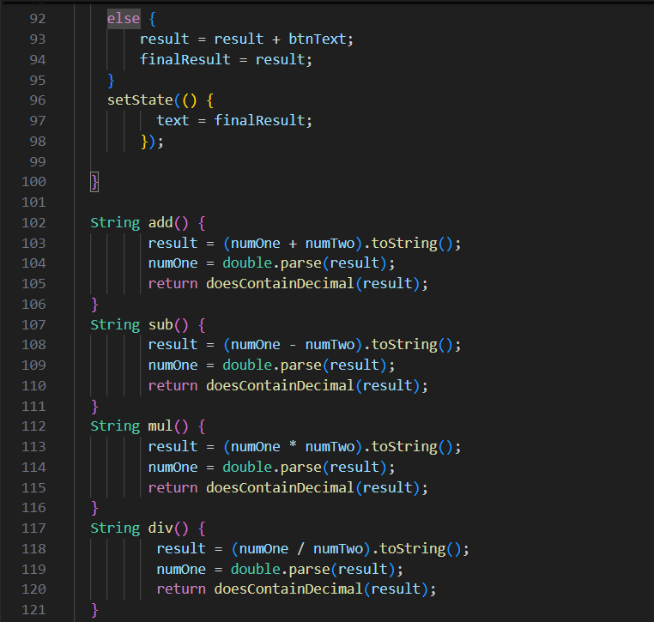
exercise

Slide 10
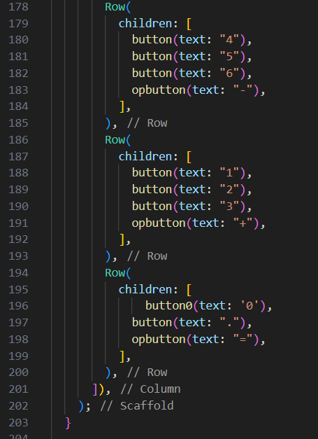
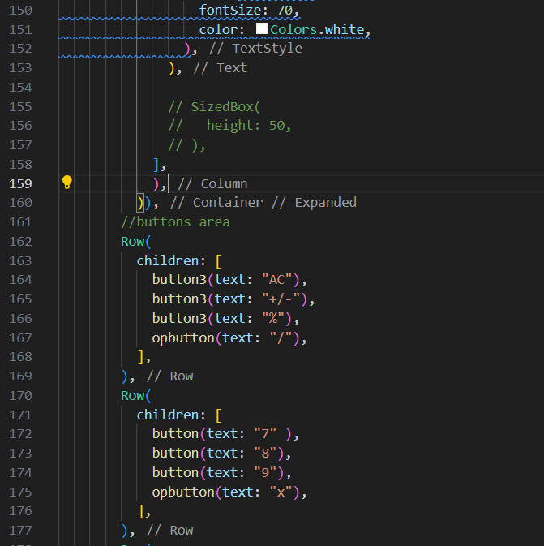
exercise

Slide 11
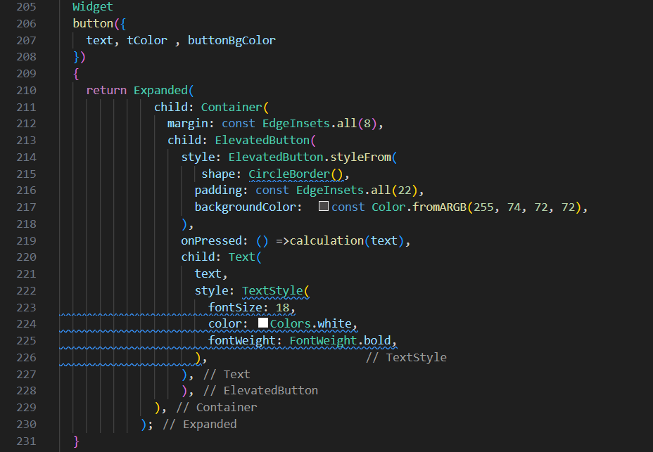
exercise

Slide 12
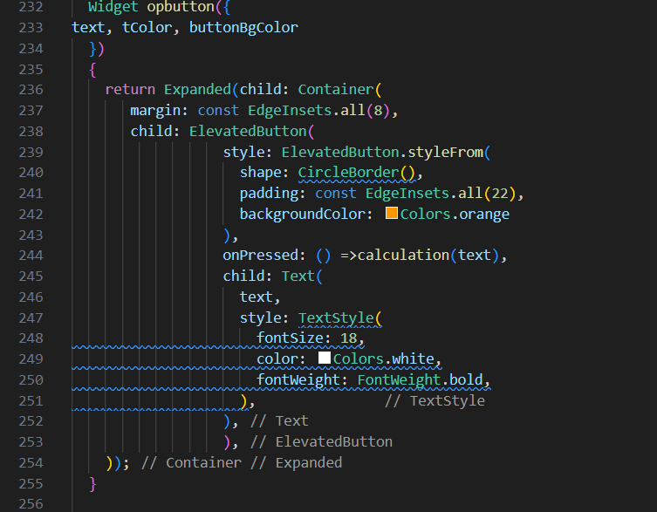
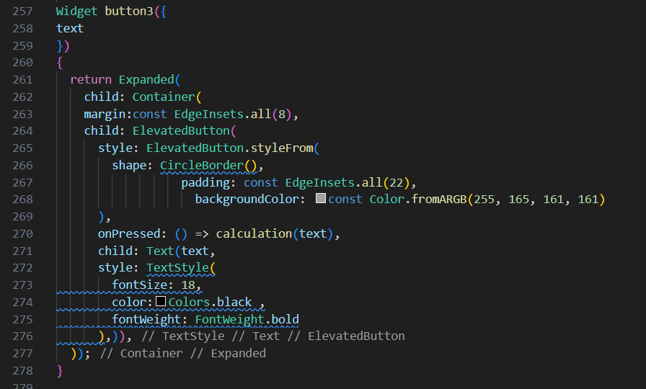

Slide 13
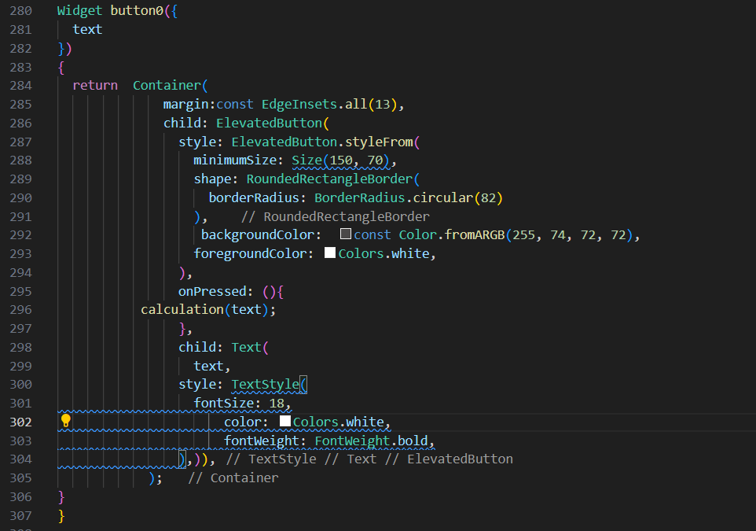

Slide 14
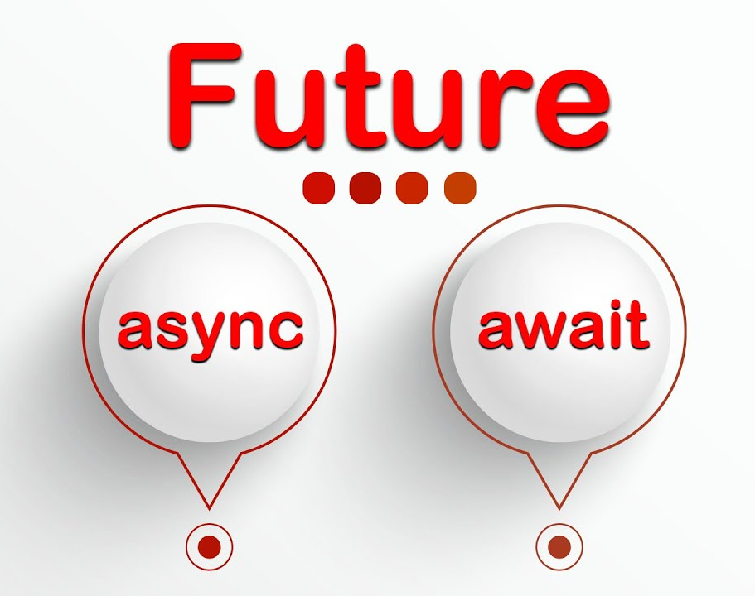
Thank you
Jubi Marva
Flutter Developer
jubimarva12@gmail.com
Aitrich Academy

